Slide 1

Customer Shopping Behavior Analysis
Uncovering insights from transactional data to guide strategic business decisions.

Slide 2

Project Overview
1
2
3
Goal
Data Source
Objective
Uncover insights into spending patterns, customer segments, product preferences, and subscription behavior.
Transactional data from 3,900 purchases across various product categories.
Guide strategic business decisions for future growth.

Slide 3

Dataset Summary
Key Features
Dataset Snapshot
Customer demographics (Age, Gender, Location, Subscription)
Rows: 3,900
Columns: 18
Purchase details (Item, Category, Amount, Season, Size, Color)
Missing Data: 37 values in Review Rating
Shopping behavior (Discount, Promo, Previous Purchases, Frequency, Review, Shipping)

Slide 4
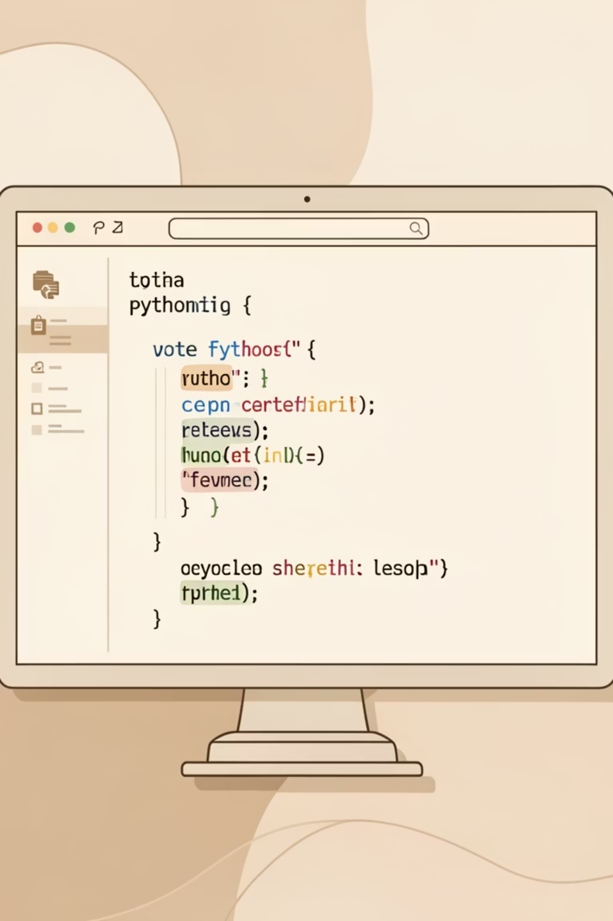
Exploratory Data Analysis (Python)
Data Loading & Exploration
Imported dataset with pandas, checked structure and summary statistics.
Data Cleaning
Handled missing values in 'Review Rating' by median imputation.
Feature Engineering
Created 'age_group' and 'purchase_frequency_days' columns.
Database Integration
Loaded cleaned data into PostgreSQL for SQL analysis.

Slide 5
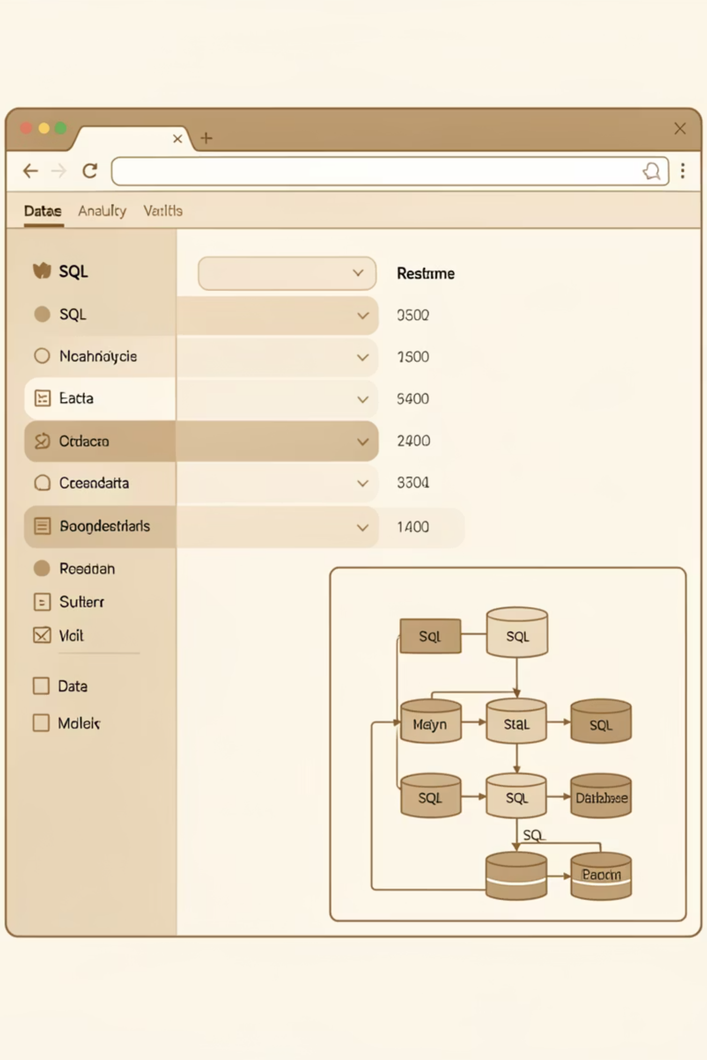

Data Analysis (SQL)
Revenue by Gender
Top 5 Products by Rating
Male: $157,890, Female: $75,191
Gloves (3.86), Sandals (3.84), Boots (3.82)
Shipping Type Comparison
Standard: $58.46, Express: $60.48

Slide 6
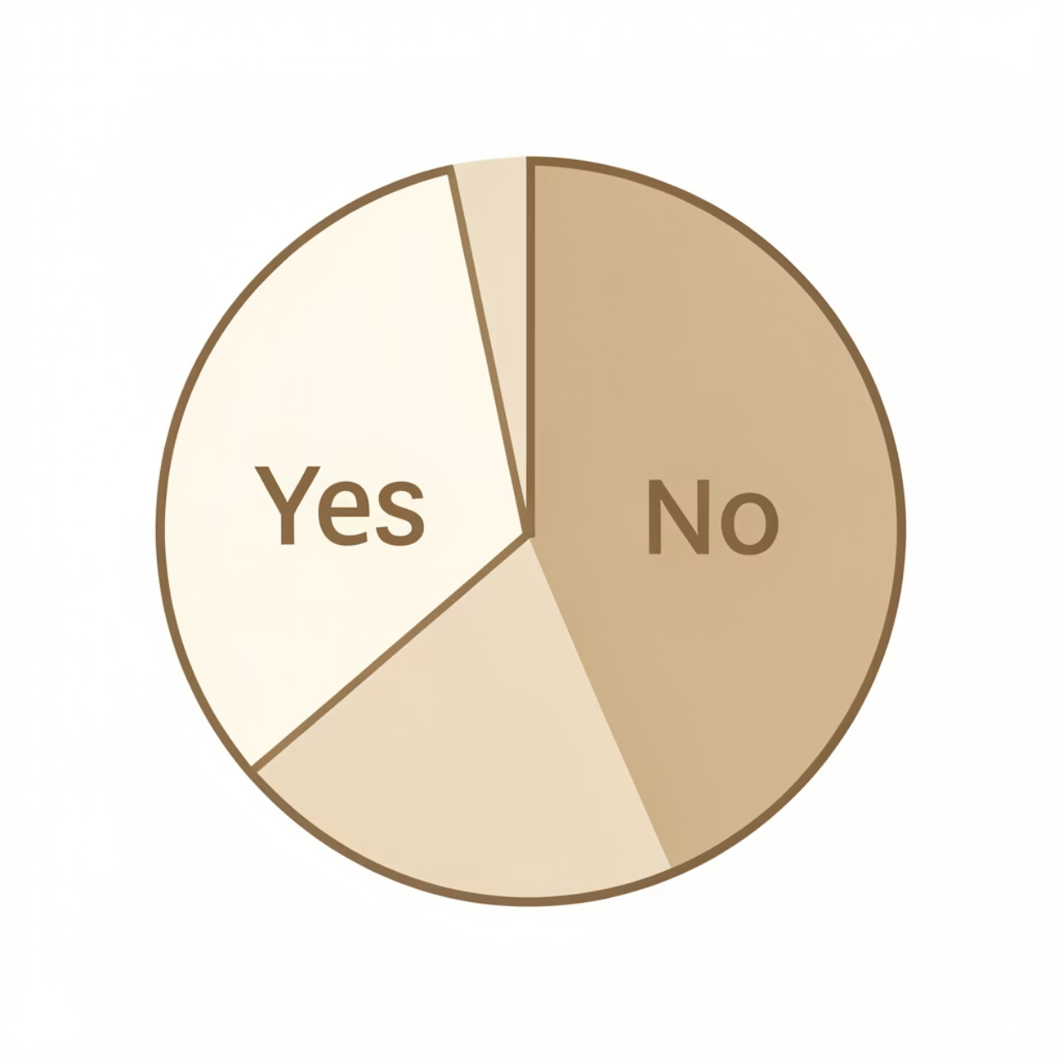
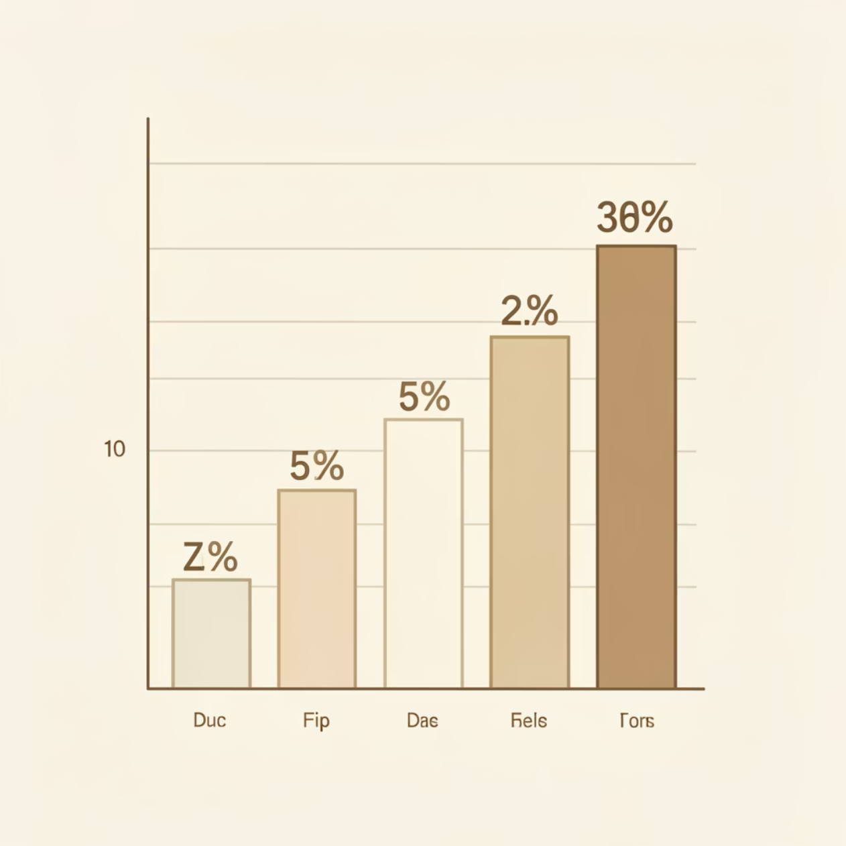
Subscription & Discount Insights
Subscribers vs. Non-Subscribers
Discount-Dependent Products
Subscribers: 1053 customers, Avg Spend: $59.49
Hat (50%), Sneakers (49.66%), Coat (49.07%)
Non-Subscribers: 2847 customers, Avg Spend: $59.87
Identified products with highest percentage of discounted purchases.

Slide 7
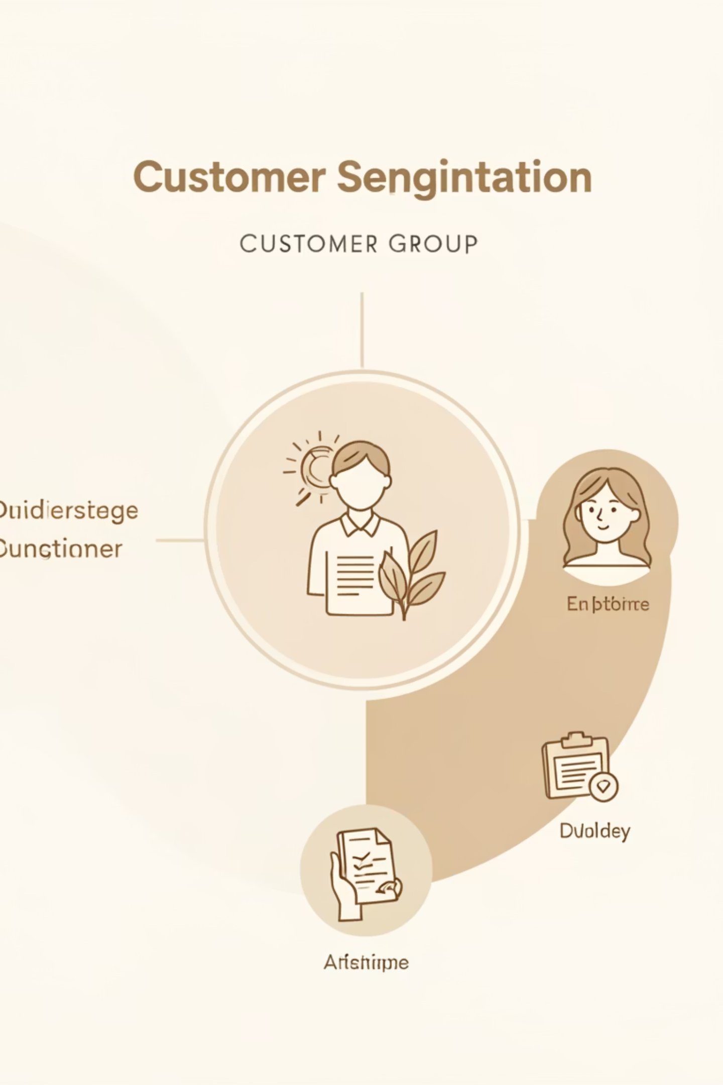
Customer Segmentation
Loyal
1
3116 Customers
Returning
2
701 Customers
New
3
83 Customers

Slide 8

Top Products by Category
Accessories
1
Jewelry (171 orders)
Sunglasses (161 orders)
Belt (161 orders)
Clothing
2
Blouse (171 orders)
Pants (171 orders)
Shirt (169 orders)
Footwear
3
Sandals (160 orders)
Shoes (150 orders)
Sneakers (145 orders)
Outerwear
4
Jacket (163 orders)
Coat (161 orders)

Slide 9
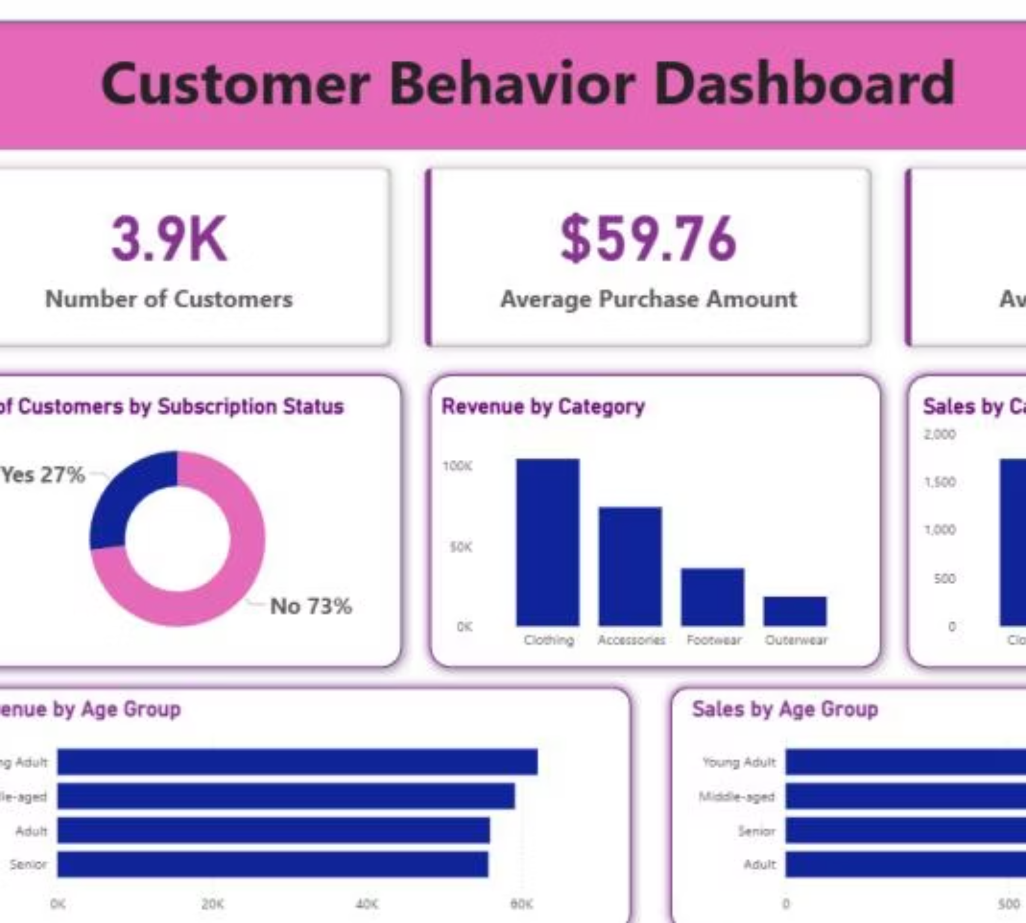
Power BI Dashboard
Interactive dashboard for visual insights:
Customer Count: 3.9K
Avg Purchase: $59.76
Avg Review: 3.75
% Subscribers: 27% Yes, 73% No

Slide 10

Business Recommendations
Boost Subscriptions
Customer Loyalty Programs
Promote exclusive benefits for subscribers.
Reward repeat buyers to foster loyalty.
Review Discount Policy
Targeted Marketing
Balance sales boosts with margin control.
Focus efforts on high-revenue age groups and express-shipping users.

